Slide 1
STOCK PRICE PREDICTION
Machine Learning Project PPT(UML501)
Submitted by
Aayushi Puri (102103676)
Submitted to
DR. Raman Kumar Goyal

Slide 2
introduction
Stock market prediction is the act of trying to determine the future value of a company stock or other financial instrument traded on an exchange. The successful prediction of a stock's future price could yield significant profit. The efficient-market hypothesis suggests that stock prices reflect all currently available information and any price changes that are not based on newly revealed information thus are inherently unpredictable. Stock market data is widely analyzed for educational, business and personal interests.

Slide 3
models
Modules used
NumPy
Pandas
Sk-learn
Matplotlib
Linear Regression:-
Linear Regression is statistical approach for modelling relationship between a dependent variable with a given set of independent variables
Example:-
x as feature vector, i.e..... x=[x_1,x_2,......x_n]
Y as response vector, i.e......y=[y_1,y_2......y_n]
Decision tree:- Decision Tree is a type of supervised learning algorithm that is commonly used in machine learning to model and predict outcomes based on input data.
It is a tree-like structure where each internal node tests on attribute, each branch corresponds to attribute value and each leaf node represents the final decision or prediction.
Output is calculated on the basis of reduced variance which we can refer to impurity factor.

Slide 4
Dataset used
For this project, we utilized historical Stock price data of HCLTECH stock at day level. The dataset includes:
Time Period: The dataset spans from January 2000 to April 2021.
Frequency: with 5300 entries
Attributes: Date, Open, High, Low, Close and Volume
Link of Dataset: https://www.kaggle.com/datasets/rohanrao/nifty50-stock-market-data

Slide 5
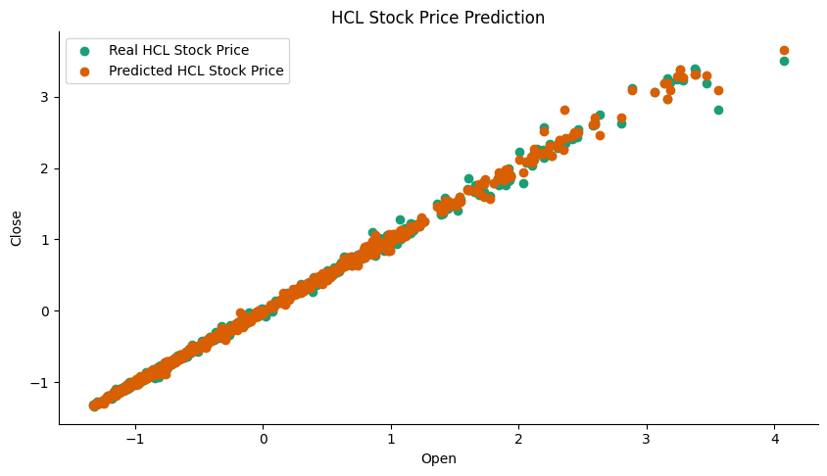
Regression Evaluation metrics
Model | MSE | MAE | R-Squared E
Decision Tree | 0.0012 | 0.0183 | 0.9987
Linear Regressor | 0.0004 | 0.0111 | 0.9995
Scatter plot

Slide 6
results
The Linear Regressor model outperformed the Decision Tree model across all key metrics. The lower MSE and MAE values indicate that the Linear Regressor provides more accurate predictions, while the higher R-squared value suggests it explains more variance in the data. However, the Decision Tree model still achieved strong results, indicating its capability to capture the underlying trends and patterns in the data despite being less accurate than the Linear Regressor. This output could vary with different datasets

Slide 7
Thank you

